Slide 1



GROUP OF INSTITUTIONS
PROJECT PRESENTATION ON,
PROJECT TITLE – COVID MANAGER
SUBMITTED BY :- AYUSH M SRIVASTAVA
UNDER SUPERVISION OF :-
Faculty Name:- Ms. Jaishree Srivastava

Slide 2
INDEX
Sno. | Title | Slide No.
1 | Introduction | 1
2 | Purpose | 2
3 | Scope | 3
4 | Problem Statement | 4
5 | Tools & Technology | 5
6 | System Design | 6
7 | Screenshots of Software | 8
8 | Conclusion | 18

Slide 3
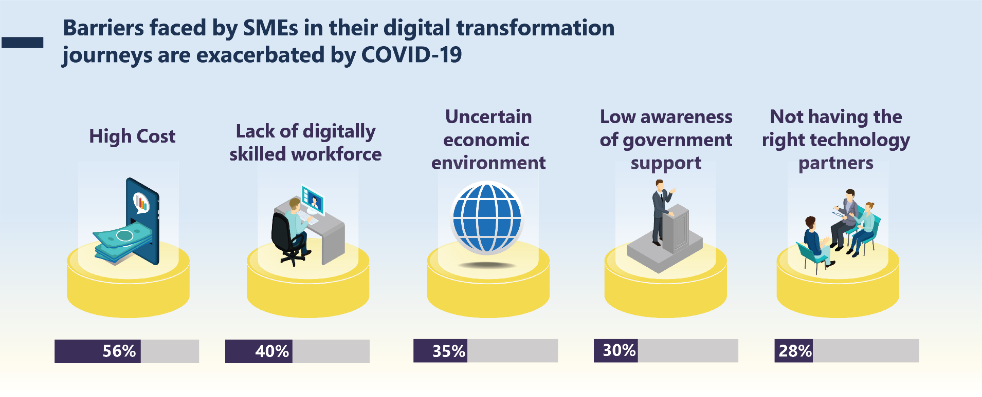


INTRODUCTION
Amidst the global impact of COVID-19, there is an urgent call for innovative solutions to effectively manage vaccination and testing. The pandemic has prompted a shift in health management practices from conventional to digital methodologies. Recognizing this evolution, the COVID-19 Management Application is conceptualized. It responds to the changing landscape of healthcare, integrating technology into traditional vaccination and testing processes. As societal norms evolve, there is a critical need for user-friendly systems to navigate health responsibilities. The application aims to address this demand by offering a holistic platform for both users and laboratories, facilitating seamless management of vaccination and testing-related information.
01

Slide 4
PURPOSE
User Management
Empower users to effortlessly oversee their vaccination and testing-related responsibilities.
Facilitate a user-friendly interface for scheduling vaccinations, accessing test results, and managing associated documentation.
Provide real-time updates and reminders to ensure users stay informed about their health commitments.
Lab Management
Enable laboratories to efficiently update results and certificates for users to access.
Streamline the process of result reporting, ensuring accuracy and timely availability.
Enhance collaboration between healthcare providers and users through a centralized platform.
02

Slide 5
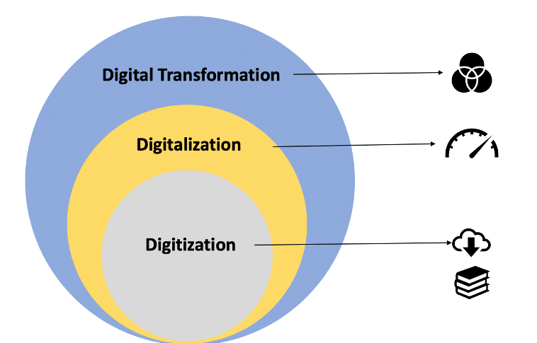
Scope

Slide 6
SCOPE
User-Friendly Interface: Designing an intuitive and easy-to-use interface for users to manage their vaccination appointments, view test results, and access certificates.
Real-Time Updates: Implementing a system for instant notifications and reminders to keep users informed about upcoming vaccinations and test result availability.
Document Management: Creating a secure repository for users to access and manage their vaccination certificates and test results.
Laboratory Integration: Developing a seamless interface for laboratories to efficiently update and manage test results and certificates.
Data Security: Prioritizing the security and confidentiality of user data, adhering to industry standards and regulations.
03

Slide 7
PROBLEM
Fragmented Information:
Inefficient management of vaccination and testing information, leading to fragmented data and potential delays in accessing critical health updates.
Communication Gaps:
Lack of streamlined communication between users and laboratories, resulting in delays or confusion regarding test results and vaccination schedules.
Documentation Challenges:
Difficulty in organizing and accessing vaccination certificates and test results, hindering individuals in meeting travel, workplace, or health-related requirements.
Data Security Concerns:
Risks associated with the security and privacy of health-related data, necessitating a robust system to safeguard sensitive information.
04

Slide 8
TOOLS & TECHNOLOGY
TECHNOLOGIES,
OPERATING SYSTEMS,
Java Swing
MySQL
NetBeans
SQL Yog
JDBC
Windows
Linux
TOOLS,
VS Code
Adobe Photoshop
05

Slide 9
SYSTEM DESIGN
HomePage
User
Login
Vaccination
Book Appointment
View Details
Change Appointment
Cancel Appointment
Check Result
Testing
Book Appointment
View Details
Change Appointment
Cancel Appointment
Check Result
SignUp
Lab
Login
Update Test Result
Update Vac Result
Signup
Exit
06

Slide 10
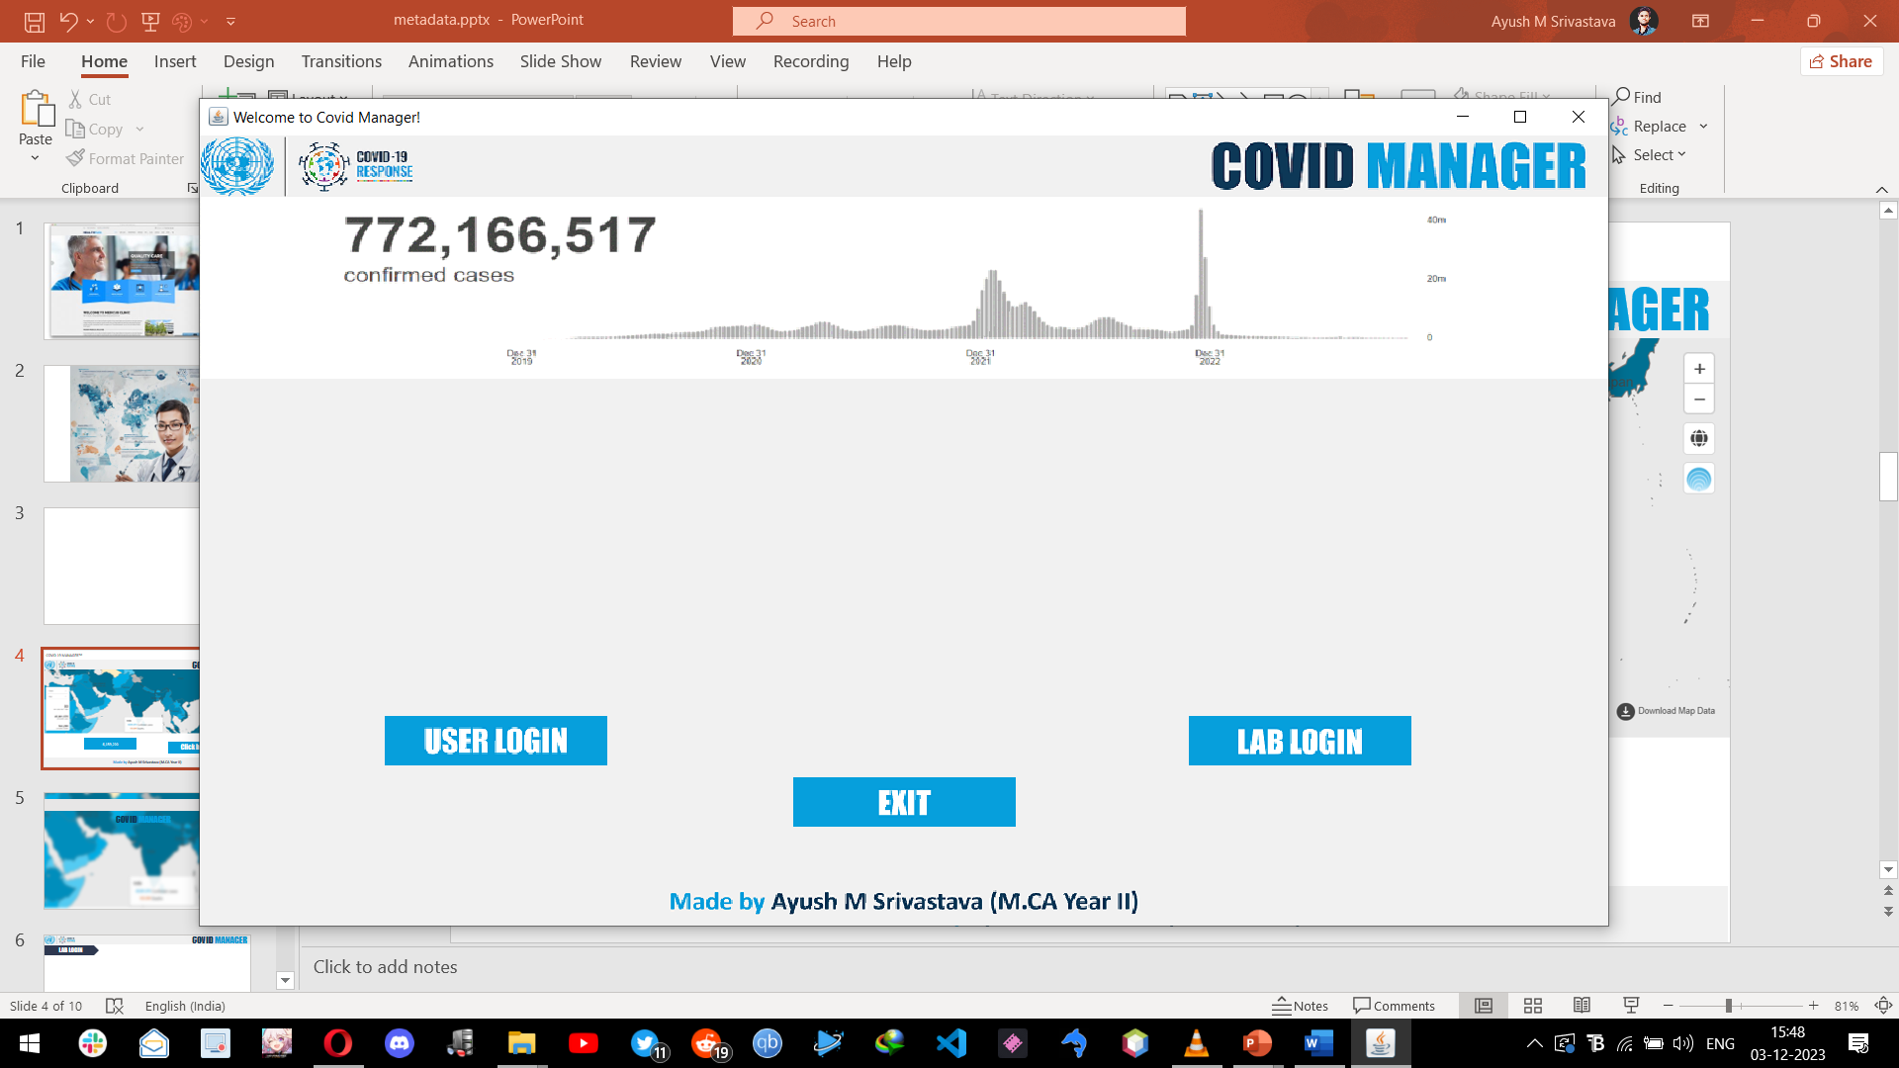
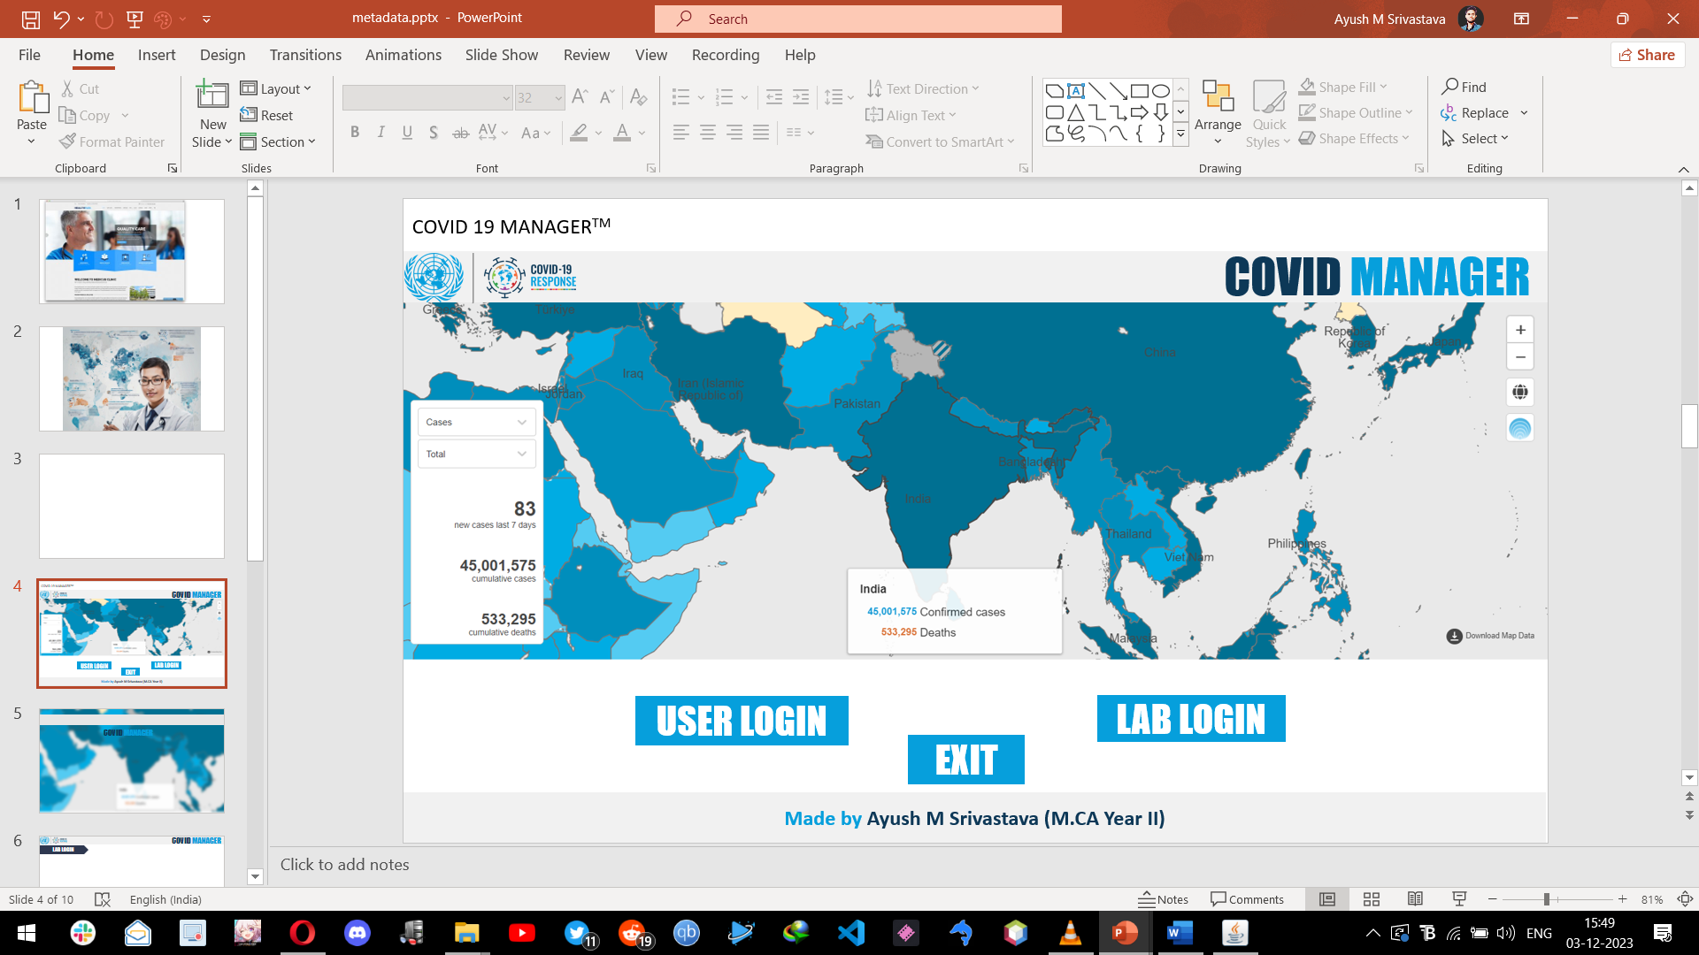
Screen Shot of Home Page
SCREENSHOTS
HomePage
08

Slide 11
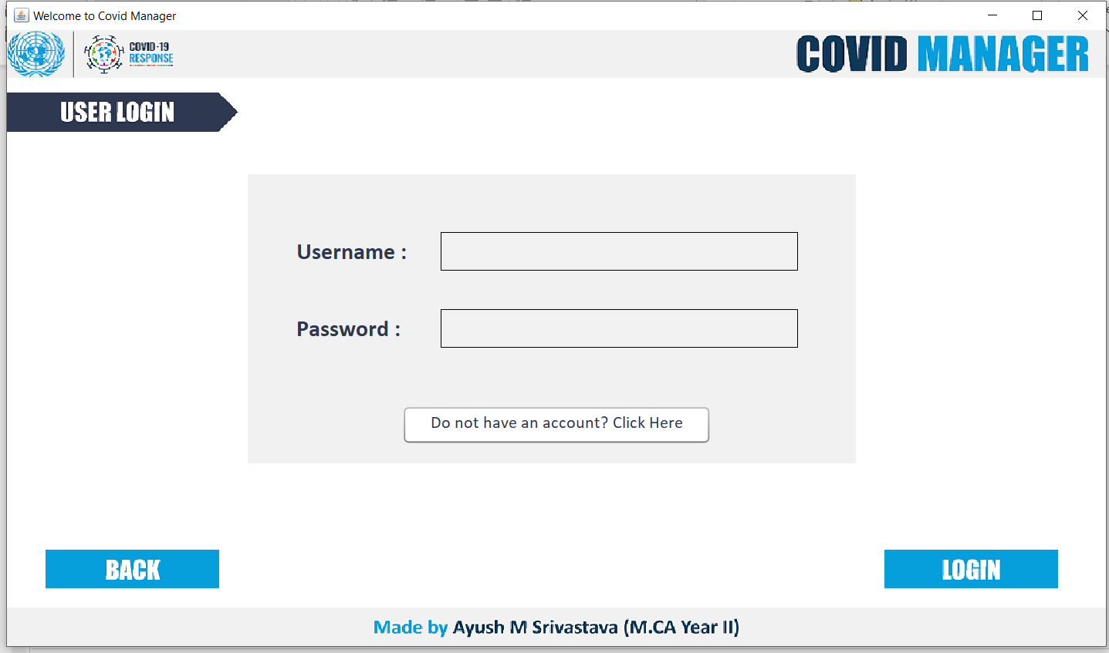
Screen Short of Registration
SCREENSHOTS
User Login Page
09

Slide 12
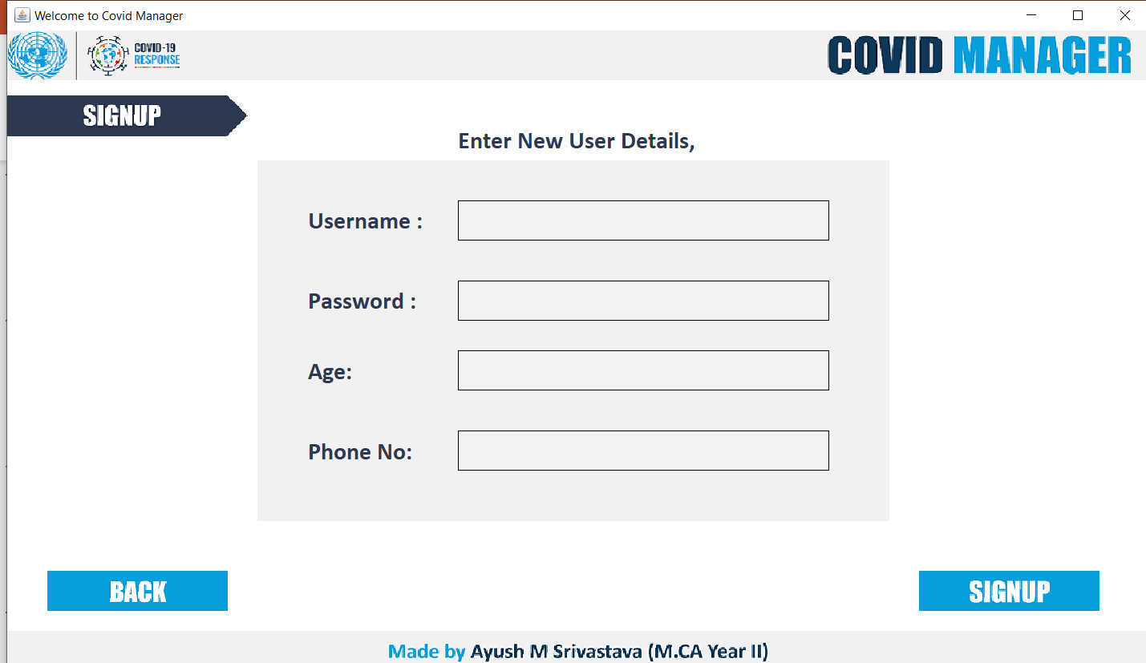
Login Page
SCREENSHOTS
User SignUp
10

Slide 13
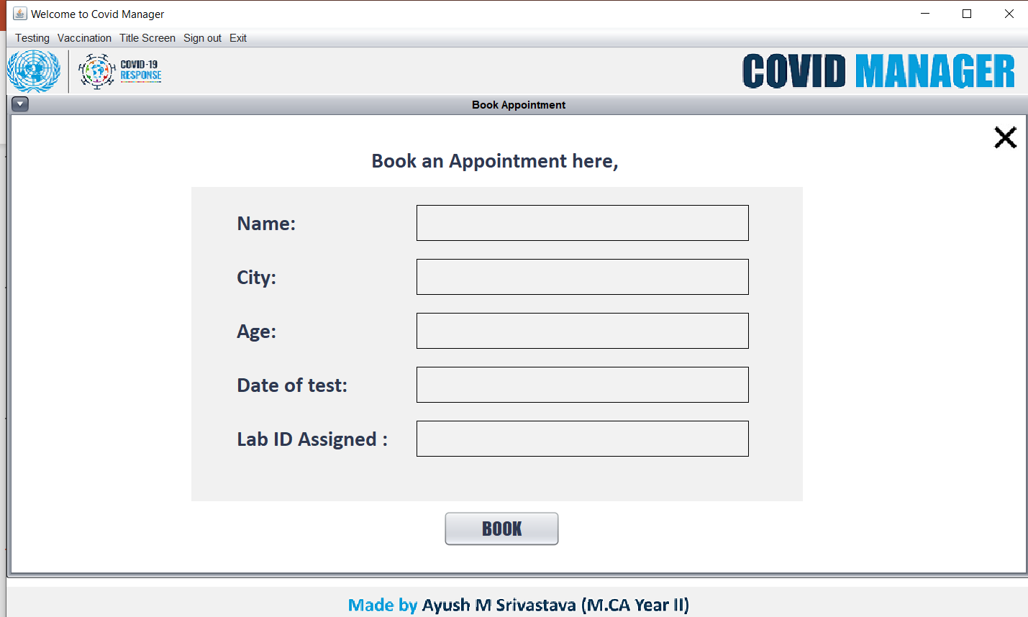
User Profile
SCREENSHOTS
Book Appointment
11

Slide 14
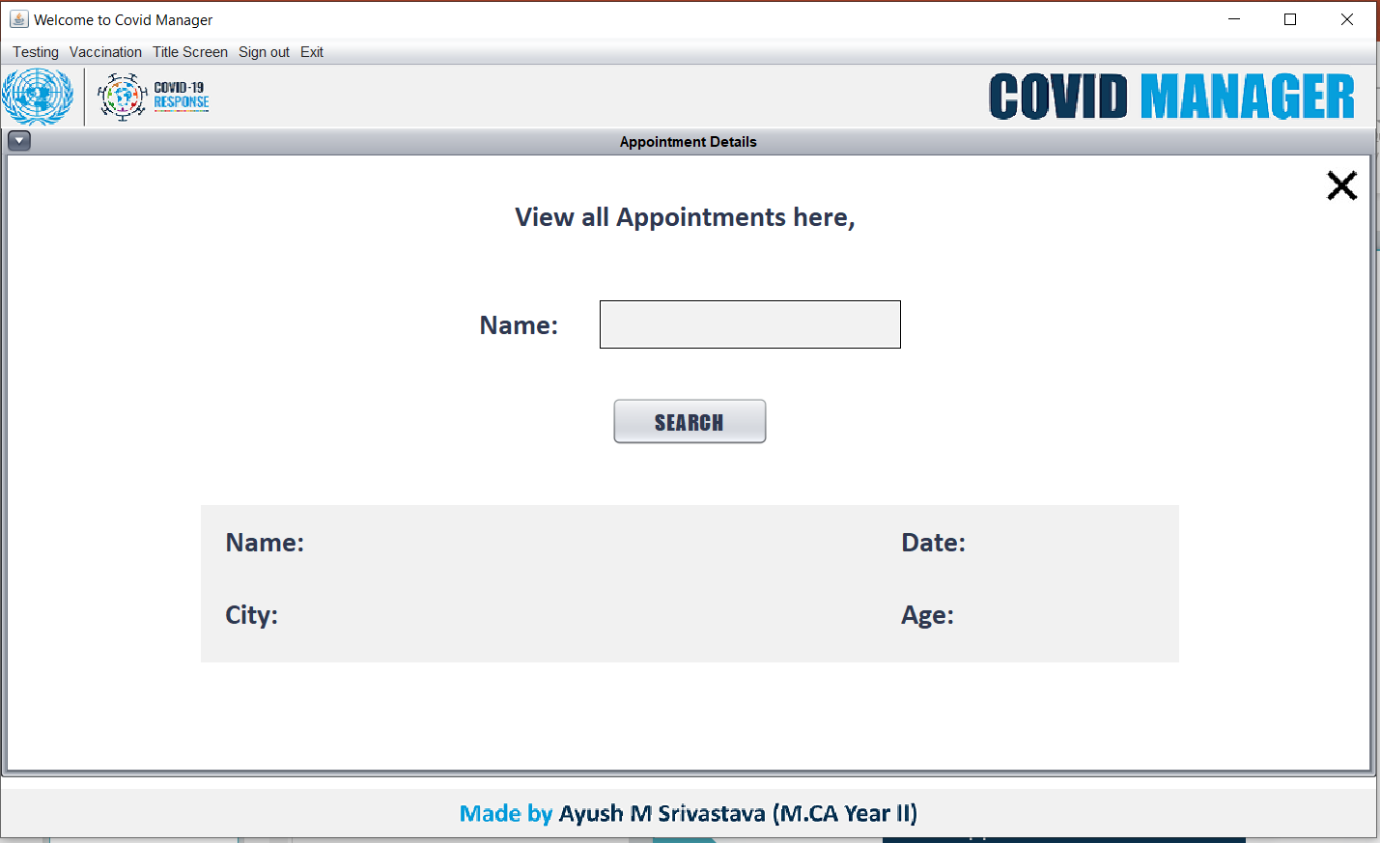
Screen Shot of about Page
SCREENSHOTS
Appointment Details
12

Slide 15
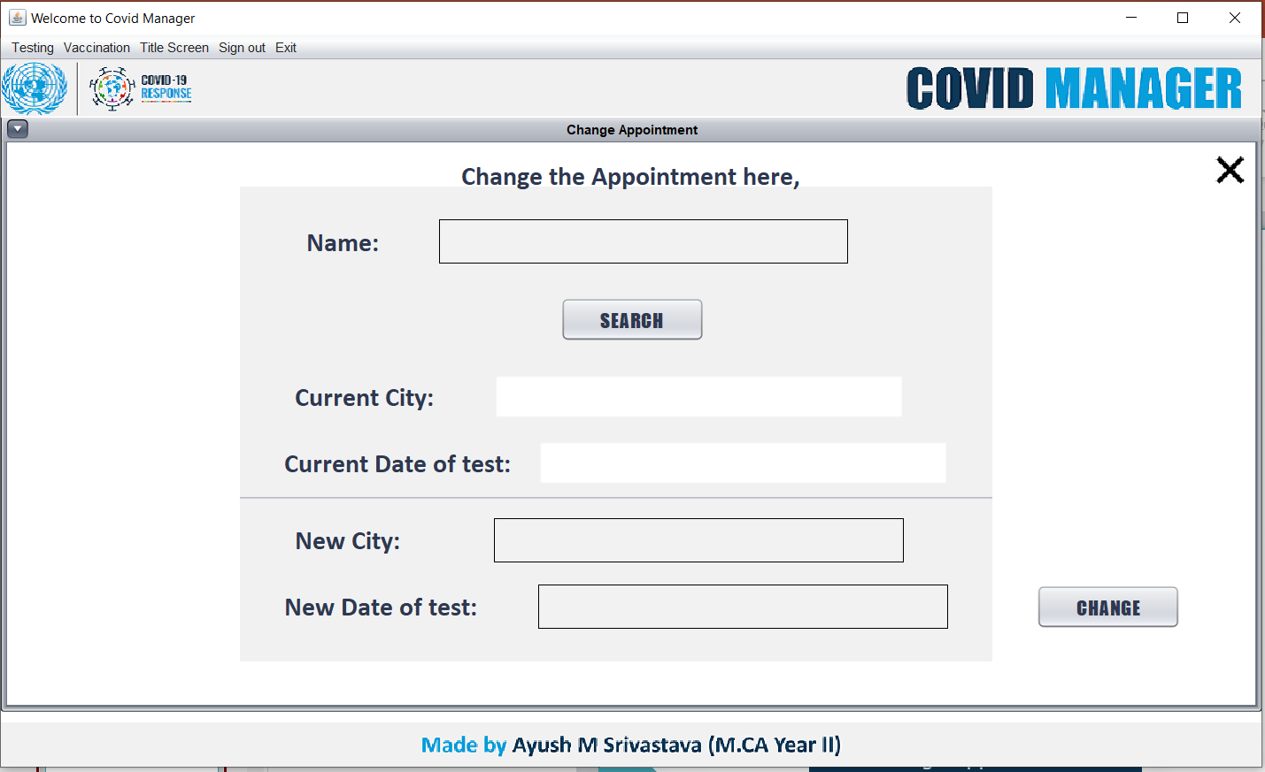
Contact
SCREENSHOTS
Change Appointment
13

Slide 16
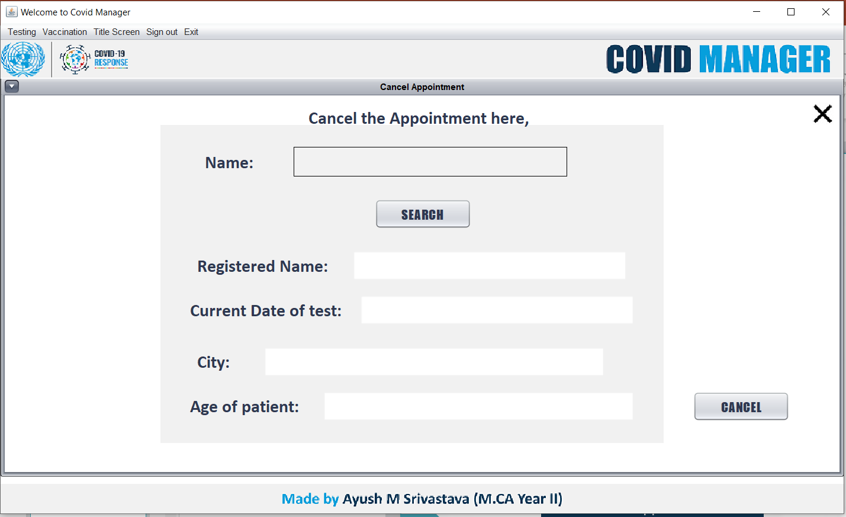
Admin Dashboard
SCREENSHOTS
Cancel Appointment
14

Slide 17
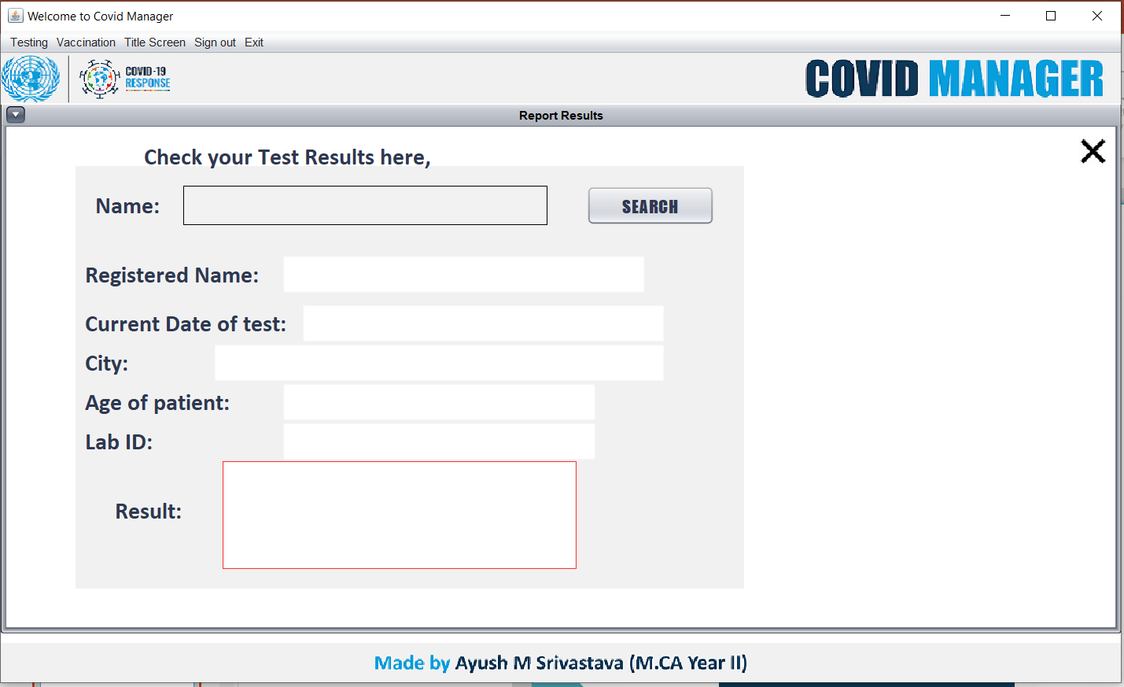
Total User
SCREENSHOTS
Check Results
15

Slide 18
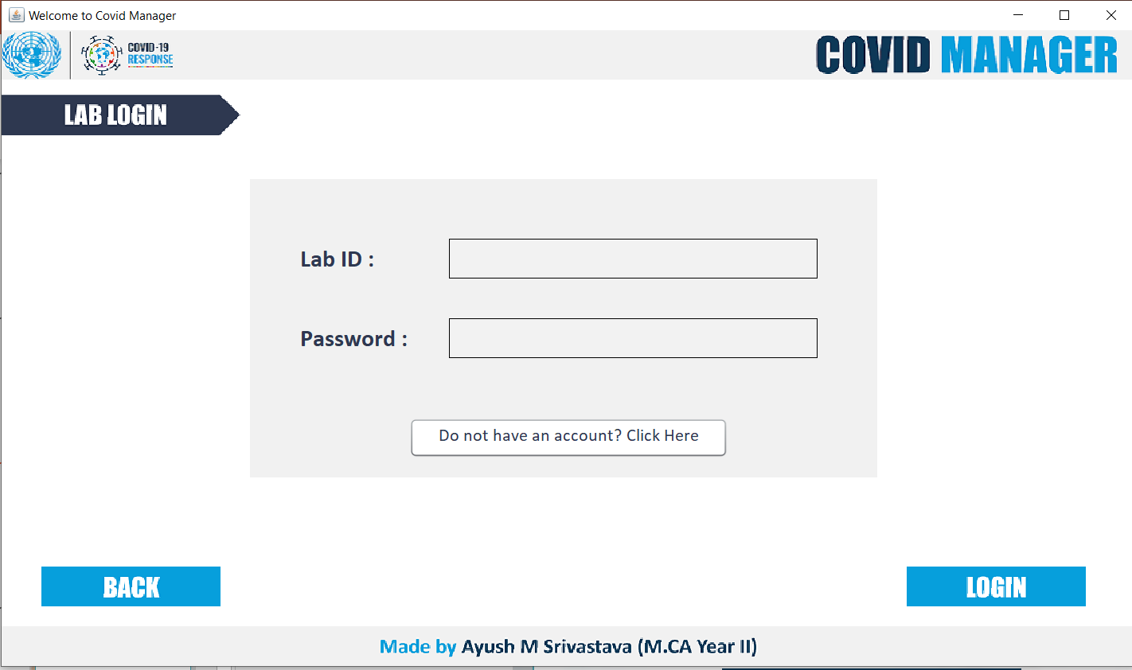
Screen Shot of Database
SCREENSHOTS
Lab Login Page
16

Slide 19
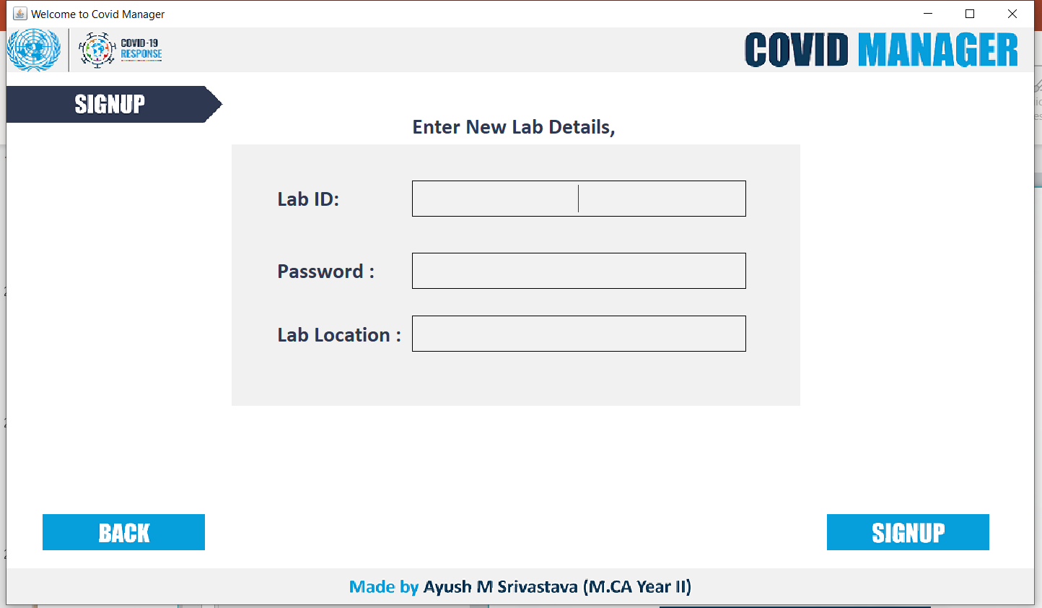
Conclusion
SCREENSHOTS
• A description of the background and context of the project and its relation to workalready done in the area.
• Made statement of the aims and objectives of the project.• The description of Purpose. Scope, and applicability
• We define the problem on which we are working in the project.
• We describe the requirement Specifications of the system and the actions that can be done on these things
.
• We understand the problem domain and produce a model of the system, whichdescribes operations that can be performed on the system.
• We included features and operations in detail, including screen layouts.
• We designed user interface and security issues related to system .Finally the system isimplemented and tested according to test cases
Lab SignUp
17

Slide 20
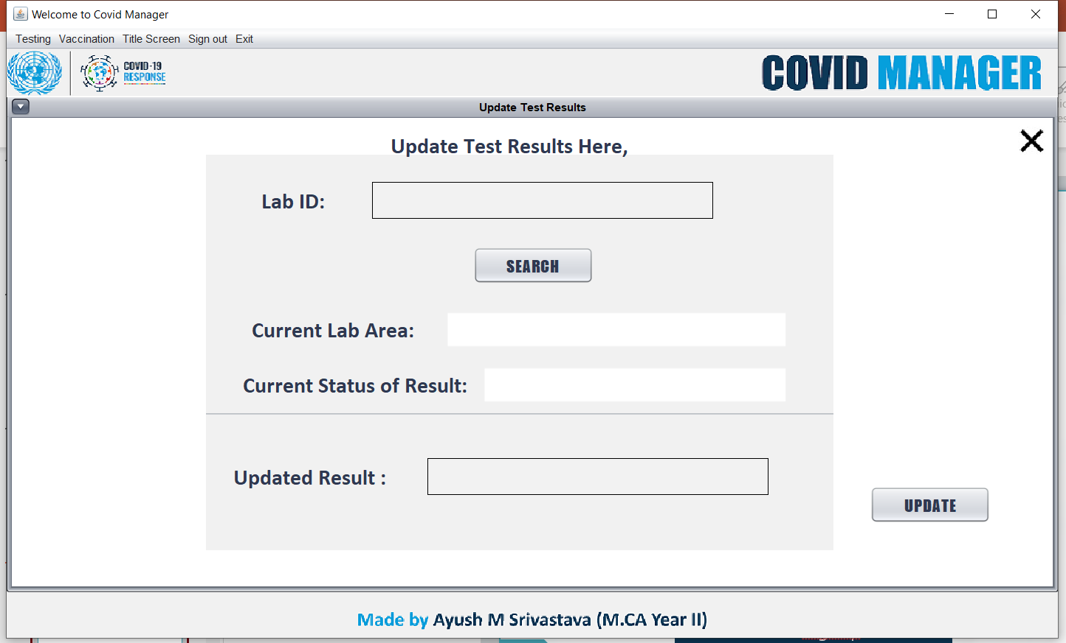
SCREENSHOTS
Update Test Results

Slide 21
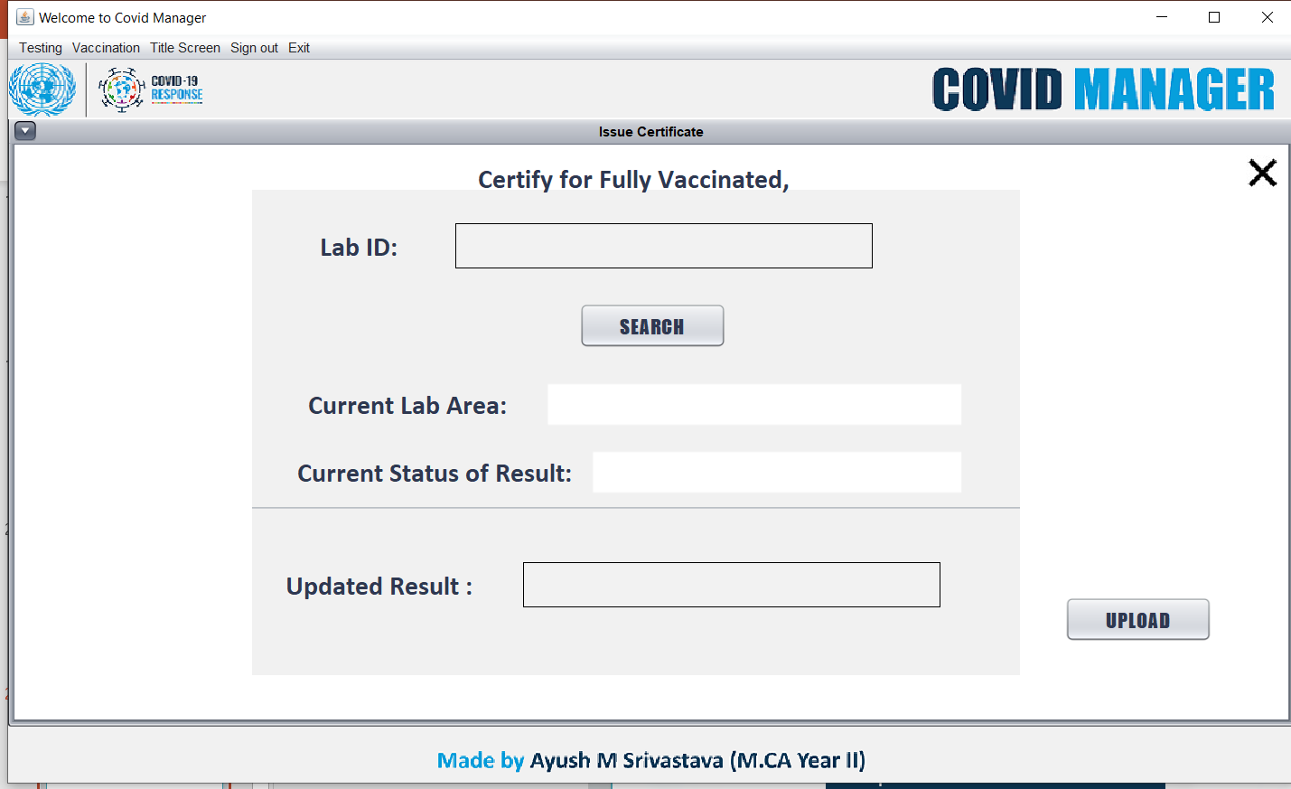
SCREENSHOTS
Update Vaccination Result

Slide 22
CONCLUSION
Project Background:
Developed in response to the COVID-19 pandemic, addressing the need for efficient management of vaccination and testing-related information.
Aims and Objectives:
Specifies objectives to integrate technology into healthcare, creating user-friendly systems for vaccination and testing management.
Purpose, Scope, and Applicability:
Defines the project's purpose, outlines scope, and highlights applicability, emphasizing user-centric design and laboratory integration.
Problem Definition:
Identifies challenges such as fragmented information, communication gaps, documentation issues, and data security concerns as intervention areas.
System Requirements and Actions:
Details system specifications and actions, providing a structured roadmap for development.
Implementation and Testing:
Ensures rigorous implementation and testing, adhering to predefined test cases for an effective, secure, and user-centric solution.
Thank you
18

Slide 23
Thank you
Thankyou !
ayushmohan

